Slide 1
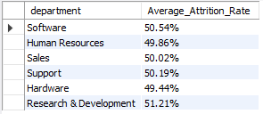
Average Attrition Rate for All Department
select a.department,
concat(format(avg(a.attrition_y)*100,2),'%') as Average_Attrition_Rate
from
( select department, attrition,
case when attrition ='Yes’ then 1
Else 0
End as attrition_y
from hr1 ) as a
group by a.department;

Slide 2

Average Hourly Rate of Male Research Scientist
Select JobRole, Format(Avg(hourlyrate),2) as Average_HourlyRate,Gender
from hr1
Where Upper(jobrole) = 'RESEARCH SCIENTIST’ And Upper(gender) = 'MALE’
group by jobrole, gender;

Slide 3
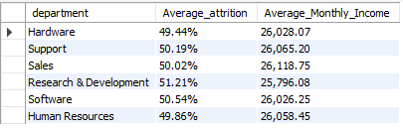
Attrition Rate VS Monthly Income stats Against Department
select a.department, concat(format(avg(a.attrition_rate)*100,2),'%') as Average_attrition,
format(avg(b.monthlyincome),2) as Average_Monthly_Income
from
( select department, attrition, employeenumber,
case when attrition = 'yes' then 1
else 0
end as attrition_rate
from hr1) as a
inner join hr2 as b
on b.employeeid = a.employeenumber
group by a.department;

Slide 4
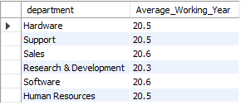
Average Working Years for Each Department
Select a.department, format(avg(b.TotalWorkingYears),1) as Average_Working_Year
from hr1 as a
inner join hr2 as b on b.EmployeeID=a.EmployeeNumber
group by a.department;

Slide 5
Job Role VS Work Life Balance
select a.JobRole,
sum( case when WorkLifeBalance = 1 then 1 else 0 end ) as 1st_Rating_Total,
sum( case when WorkLifeBalance = 2 then 1 else 0 end ) as 2nd_Rating_Total,
sum( case when WorkLifeBalance = 3 then 1 else 0 end ) as 3rd_Rating_Total,
sum( case when WorkLifeBalance = 4 then 1 else 0 end ) as 4th_Rating_Total,
count(b.WorkLifeBalance) as Total_Employee
from hr1 as a
inner join hr2 as b
on b.EmployeeID = a.Employeenumber
group by a.jobrole;

Slide 6
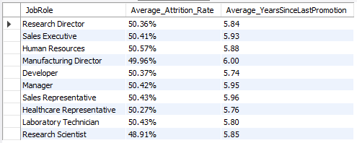
Attrition Rate VS Year Since Last Promotion Relation Against Job Role
Select a.JobRole, concat(format(avg(a.attrition_rate)*100,2),'%') as Average_Attrition_Rate,
format(avg(b.YearsSinceLastPromotion),2) as Average_YearsSinceLastPromotion
from
( select JobRole, attrition, employeenumber,
case when attrition = 'yes' then 1
else 0
end as attrition_rate from hr1 ) as a
inner join hr2 as b
on b.employeeid = a.employeenumber
group by a.JobRole;

